Slide 1
Advanced Computer Vision
Amal Joseph
Machine Learning Engineer @ Arcesium

Slide 2
Overview
Object Detection
Image Segmentation
Facial Recognition
Hands-on

Slide 3
Understanding Computer Vision Tasks

Slide 4
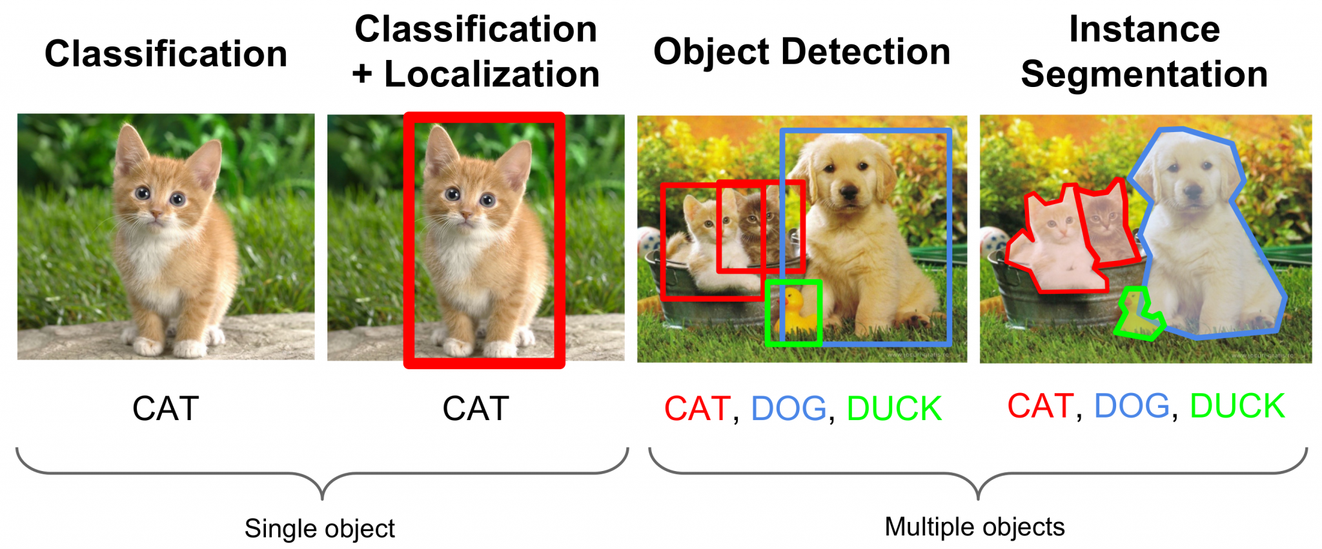
Image Classification

Slide 5
Image Localization

Slide 6
Object Detection

Slide 7
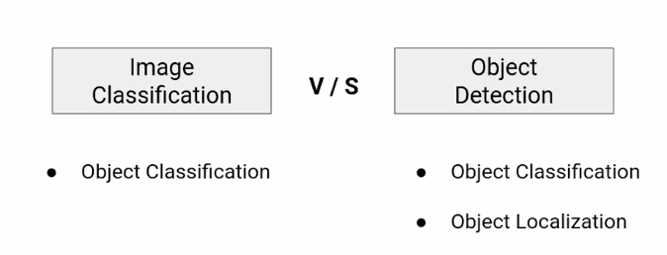

Slide 8
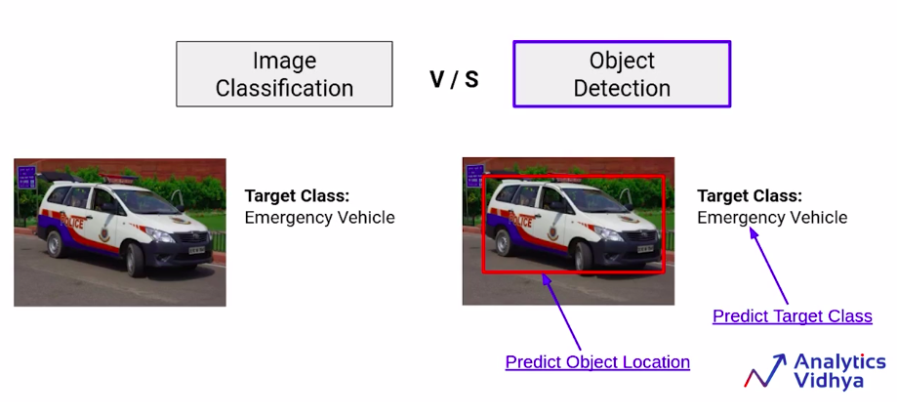

Slide 9
Image/ Instance Segmentation

Slide 10
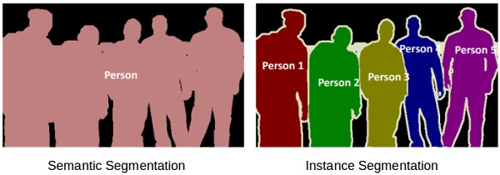
Semantic Segmentation vs Instance Segmentation

Slide 11
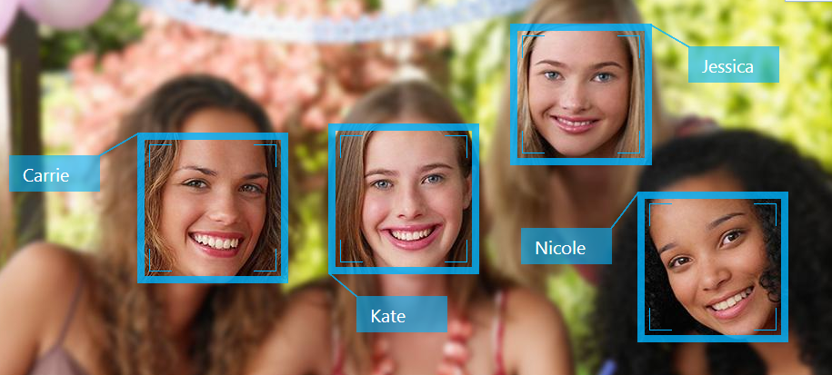
Facial Recognition

Slide 12
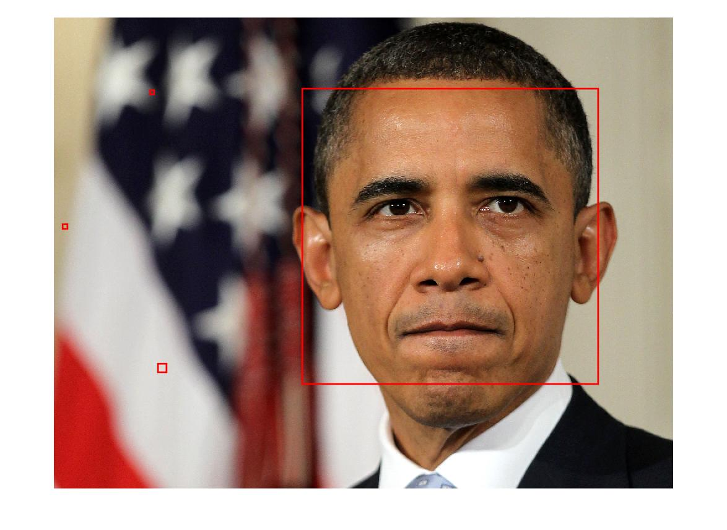
3 Step Process
Face Detection
The very first task we perform is detecting faces in the image or video stream. Now that we know the exact location/coordinates of face, we extract this face for further processing ahead.

Slide 13
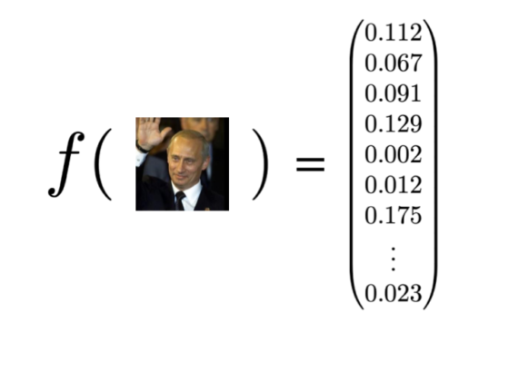
3 Step Process
Feature Extraction/ Face Embeddings
Now that we have cropped the face out of the image, we extract features from it. Here we are going to use face embeddings to extract the features out of the face

Slide 14
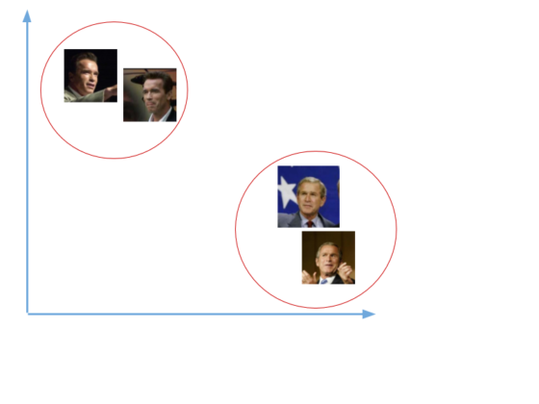
3 Step Process
Face Recognition
Similar faces would have similar embeddings/ encodings.
So they’ll be closer in the vector space

Slide 15
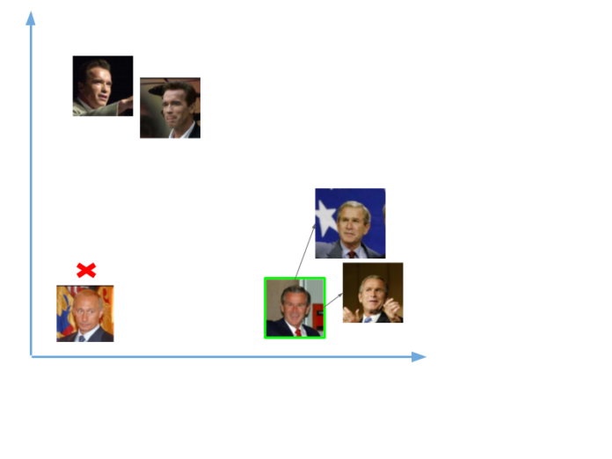
3 Step Process
Face Recognition
Comparing faces
Face embeddings are compared to find a match.

Slide 16
Time for Hands On
Object Detection Notebook bit.ly/day13_notebook1

Slide 17
Time for Hands On
Image Segmentation Notebook bit.ly/day13_notebook2

Slide 18
Time for Hands On
Facial Recognition bit.ly/day13_notebook3

